Slide 1

lesson 5
    Operating Systems

Slide 2
This lesson includes the following sections:
    The User Interface
    Running Programs
    Managing Files
    Managing Hardware
    Operating Systems in Review

Slide 3
The User Interface
Graphical User Interfaces (GUIs)
GUI Tools
Applications and the Interface
Menus
Dialog Boxes
Command-Line Interfaces

Slide 4
  The User Interface -
  Graphical User Interfaces (GUIs)
Most modern operating systems provide a graphical user interface (GUI).
In a GUI, you control the system by using a mouse to click graphical objects on screen.
A GUI is based on the desktop metaphor. Graphical objects appear on a background (the desktop), representing resources you can use.

Slide 5
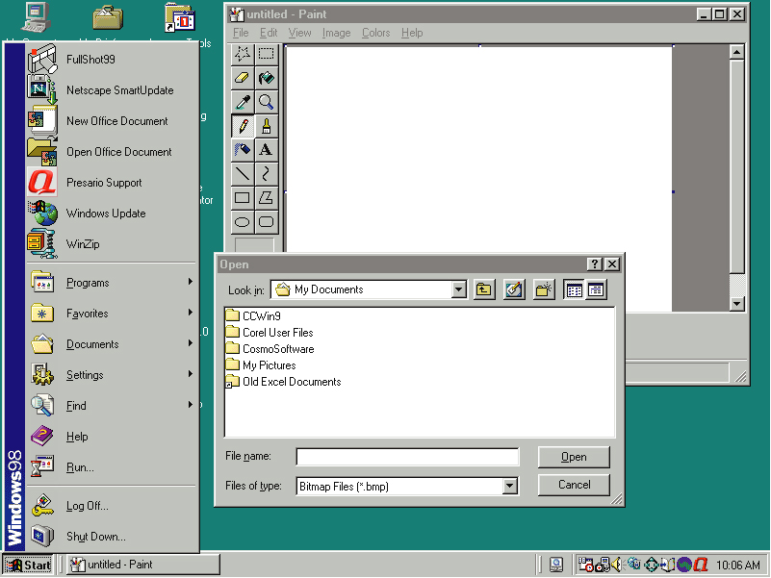
Icons
Program
running in
a window
Desktop
Window control buttons
Start menu
Start button
Dialog box
Taskbar

Slide 6
The User Interface -
GUI Tools
Icons are pictures that represent computer resources, such as printers, documents, and programs.
You double--click an icon to choose (activate) it--for instance, to launch a program.
Windows offers two unique tools--called the taskbar and Start button--to help you run and manage programs.

Slide 7
  The User Interface –
  Applications and the Interface
In a GUI, each program runs in a separate window—a frame that presents the program and its documents.
In a GUI, you can run multiple programs at once, each in a separate window. The application in use is said to be the active window.

Slide 8
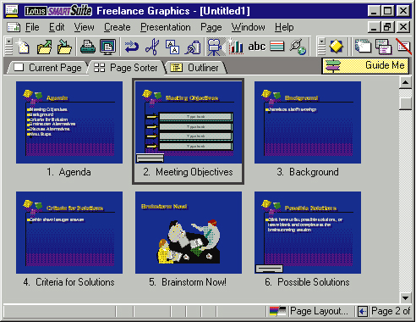
Titlebar
Menubar
Scroll arrow
Click the Minimize button to reduce
the program to a button on the taskbar.
Click the Maximize button to restore
the window to its previous size.
Click the Close button to close
the window altogether.
Toolbar
Scroll box
Scroll bar

Slide 9
The User Interface -
Menus
GUI-based programs let you issue commands from menus.
A menu groups related commands. For example, the File menu command lets you open, save, and print document files.
To execute a command from a menu, just click it.

Slide 10
The User Interface -
Dialog Boxes
A dialog box is a special window that appears when a program or the OS needs information before completing a task.
Dialog boxes are so named because they conduct a "dialog" with the user, asking the user to provide more information or make choices.

Slide 11
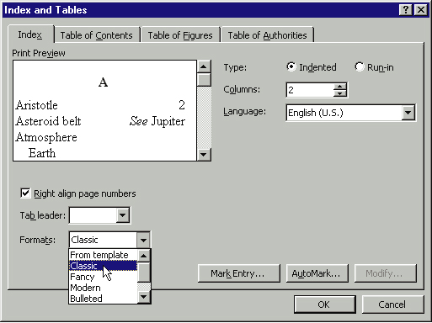

Slide 12
.
The User Interface -
Command-Line Interfaces
Some older operating systems use command-line interfaces.
In a command-line interface, you type commands at a prompt.
DOS and UNIX are examples of operating systems that provide command-line interfaces.

Slide 13
Running Programs
Basic Services
Sharing Information
Multitasking

Slide 14
Running Programs -
Basic Services
The OS manages all the other programs that run on the PC.
The OS provides services to programs and the user, including file management, memory management, and printing.
To provide services to programs, the OS accepts system calls—requests from hardware and software programs to perform tasks.

Slide 15
Running Programs -
Sharing Information
Some operating systems enable programs to share information.
You can create data in one program and reuse it in other programs.
Windows provides the Clipboard, a special area that stores data cut or copied from one document, so you can reuse it elsewhere.

Slide 16
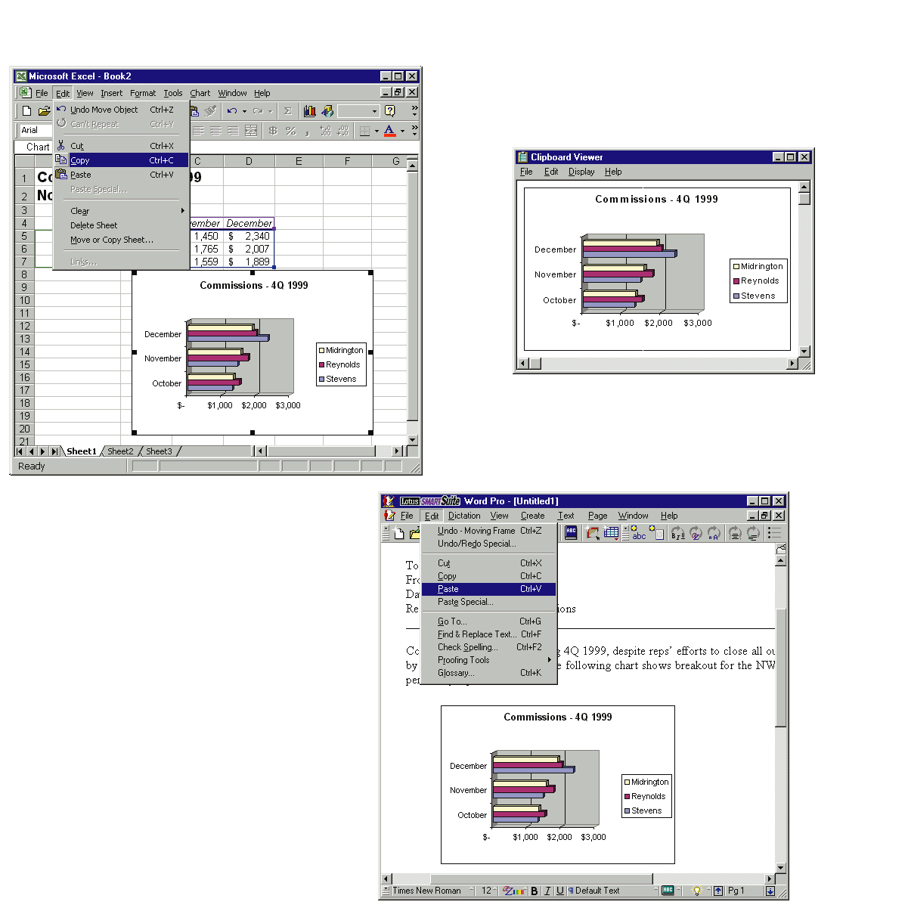

2
1
1
Information is clipped
from one application (Excel)
2
Using the clipboard Viewer to
examine the information
3
3
Pasting the information
into another application (WordPro)

Slide 17
Running Programs -
Multitasking
A multitasking OS lets you run multiple programs or perform multiple processes at the same time.
Through multitasking, you can do several chores at one time, such as printing a document while downloading a file from the Internet.

Slide 18
Managing Files
The OS keeps track of all the files on each disk.
Users can make file management easier by creating a hierarchical file system that includes folders and subfolders arranged in a logical order.

Slide 19
Managing Hardware
The OS uses interrupt requests (IRQs) to maintain organized communication with the CPU and other devices.
Each device is controlled by a piece of software, called a driver, which allows the OS to activate and use the device.
The OS provides the software for linking computers to form a network.

Slide 20
Operating Systems in Review
UNIX
DOS
The Macintosh Operating System
Windows 3.x
OS/2 Warp
Windows NT
Windows 95 and 98
Linux
Windows 2000

Slide 21
Operating Systems in Review -
UNIX
UNIX is the oldest operating system used on PCs.
UNIX is a multi-user, multiprocessor, multitasking operating system.
Most versions of UNIX use a command-line interface, but some versions offer a GUI.

Slide 22
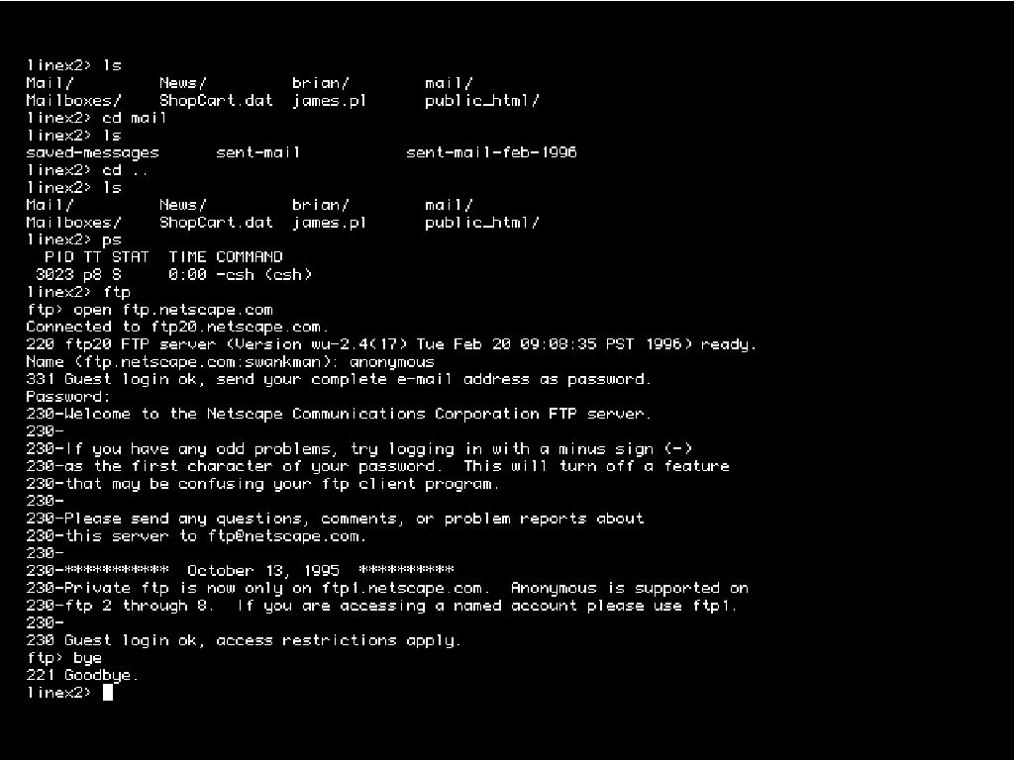

Slide 23
Operating Systems in Review -
DOS
IBM adopted DOS as the operating system for early IBM PCs. For years, DOS was the dominant OS on IBM and compatible personal computers.
DOS features a command-line interface, and does not support multitasking or multiprocessing.
Though not terribly powerful, DOS is reliable and stable.

Slide 24
Operating Systems in Review -
The Macintosh Operating System
The Macintosh OS supports the graphical nature of the Macintosh computer.
The Mac OS brought the first truly graphical user interface to consumers.
All applications running under the Mac OS provide the same "look and feel" to the user.

Slide 25
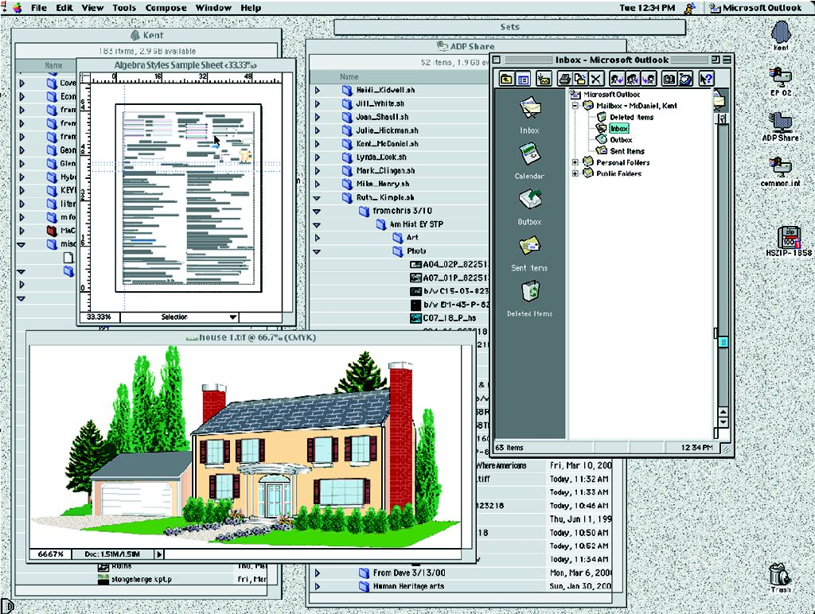

Slide 26
Operating Systems in Review -
Windows 3.X
Windows 3.0, 3.1, and 3.11 are called the Windows 3.x family.
Windows 3.x brought a GUI to PCs running DOS.
Windows 3.x is an operating environment because it ran on top of DOS, which was the actual OS.

Slide 27
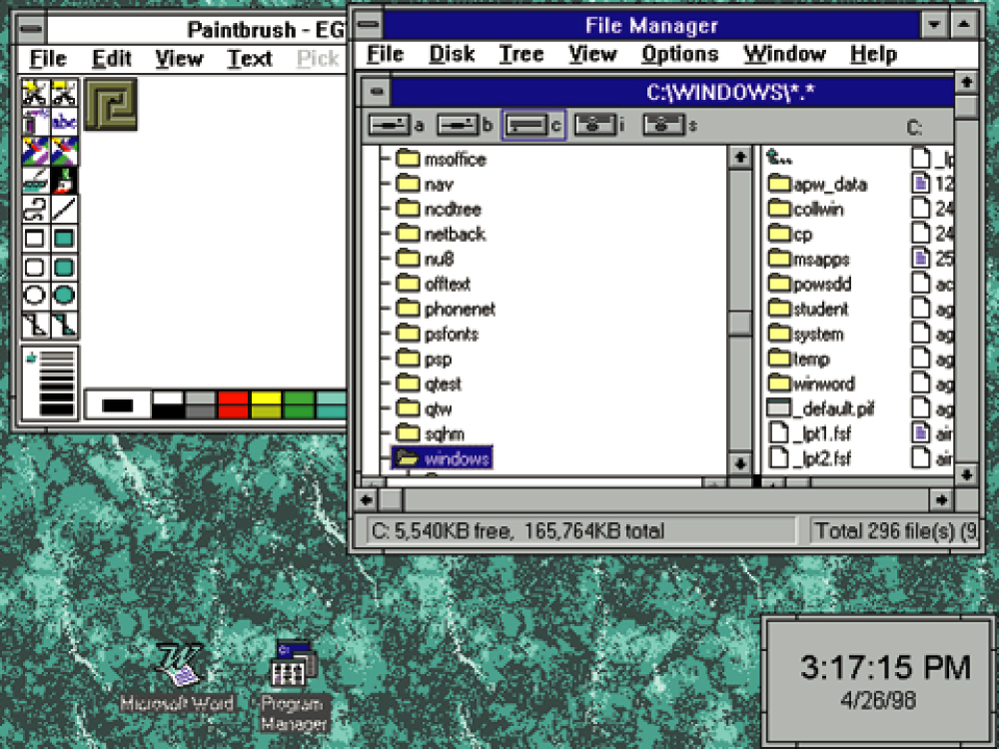

Slide 28
Operating Systems in Review -
OS/2 Warp
OS/2 Warp was the first true GUI-based operating system for Intel-based PCs.
OS/2 is a multitasking OS that provides support for networking and multiple users.
OS/2 was the first PC OS to feature built-in speech recognition capabilities.

Slide 29
Operating Systems in Review -
Windows NT
Microsoft's Windows NT was meant as a replacement for DOS, but was too resource- intensive to work on most PCs at the time of its release.
Microsoft issued two versions of Windows NT—Windows NT Workstation and Windows NT Server.
NT is a very powerful and robust OS, resistant to system crashes.

Slide 30
Operating Systems in Review -
Windows 95 and 98
Windows 95 was Microsoft's first true GUI-based, 32-bit operating system for Intel PCs.
Windows 95 supports multitasking and can run older DOS and Windows 3.x programs.
Windows 98's features include advanced Internet capabilities, an improved GUI, and enhanced file system performance, among others.

Slide 31
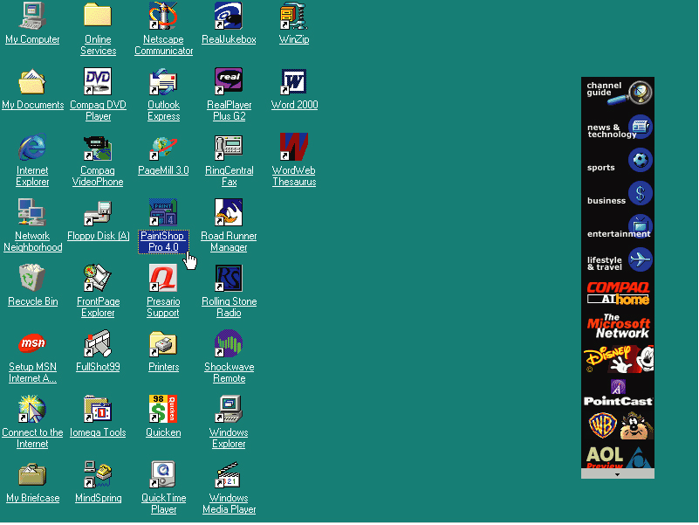

Slide 32
Operating Systems in Review -
Linux
Linux is a recently developed version of UNIX, which is available for free or at a very low cost from various sources.
Linux is a very powerful 32-bit OS that supports multitasking, multiple users, networking, and virtually any application.
Linux can run on nearly any type of computer.

Slide 33
Operating Systems in Review -
Windows 2000
Windows 2000 features the same interface and features of Windows 98, with the file system, networking, power, and stability of Windows NT.
Several versions of Windows 2000 are available, each targeting a specific user or computing environment.

Slide 34
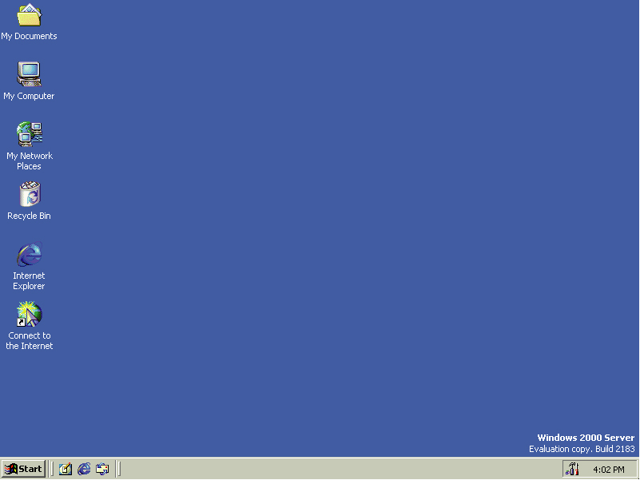

Slide 35
lesson 5 review
Identify four components found in most graphical user interfaces.
Describe the operating system’s role in running software programs.
Explain how the operating system enables users to manage files.
List three ways the operating system manages the computer’s hardware.
Identify one key feature of each common PC operating system.

